Slide 1



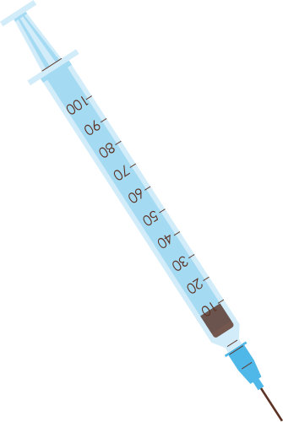



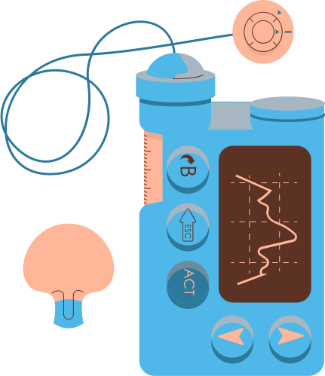


BOSTON UNIVERSITY
EXPLORING AND ANALYZING HEALTHCARE TRENDS IN SYNTHETIC MEDICARE DATA
IS843 TEAM 5
ATHARVA, HRISHAV, PARISA, SHRAVANI, WILLEM

Slide 2



PROBLEM DEFINITION
EXPLORE HEALTHCARE
SERVICE UTILIZATION AND DEMAND BASED ON PATIENT DEMOGRAPHICS AND HEALTH OUTCOMES

Slide 3

PROJECT GOALS
Identify different distribution services and analyze their services across different counties or hospitals.
Identify patterns in service utilization that may indicate disease prevalence variations by geographical area or season
Analyze the trends of mortality rates over years associated with different types of care.
Explore and understand the significance of gender and demographics of patients in receiving the care they need.
Explore the dollar cost impact that patients face.

Slide 4

DATA SOURCE
Center for Medicare & Medicaid Services Synthetic Patient Data:
Google Big Query
PERSON -
ROWS: 2,326,856 FEATURES: 14
DEATH -
ROWS: 107, 644 FEATURES: 7
LOCATION -
ROWS: 3,185 FEATURES: 8
OBSERVATION PERIOD -
ROWS: 2,098,515 FEATURES: 5
PROCEDURE OCCURRENCE -
ROWS: 278,769,529 FEATURES: 14
PROVIDER -
ROWS: 905,492 FEATURES: 13
CONDITION ERA -
ROWS: 223,393,336 FEATURES: 6
DOSE ERA -
ROWS: 122,262,518 FEATURES: 7
COST -
ROWS: 748,940,384 FEATURES: 22
PAYER PLAN PERIOD -
ROWS: 7,789,512 FEATURES: 17
CONCEPT -
ROWS: 3,902,588 FEATURES: 10
THE CMS SYNTHETIC PATIENT DATA IN BIGQUERY OFFERS A SIMULATED SNAPSHOT OF MEDICARE INSURANCE CLAIMS FROM 2008-2010. IT INCLUDES ANONYMIZED INFORMATION ON 2.33 MILLION PATIENTS, ENCOMPASSING DIAGNOSES, PROCEDURES, MEDICATIONS, ENCOUNTERS, AND PROVIDER DETAILS. WHILE NOT REFLECTING REAL INDIVIDUALS, THIS DATA ALLOWS RESEARCHERS TO EXPLORE HEALTHCARE TRENDS AND PATTERNS RELATED TO DISEASE PREVALENCE, MORTALITY RATES, PROVIDER ANALYSIS, AND COST ANALYSIS.

Slide 5

MOTIVATION
As the healthcare landscape continues to change, characterized by increasing costs, varying disease prevalence, and demographic shifts, we think it’s crucial to understand and optimize healthcare services across various settings and populations. Our motivation is to help the US healthcare system in improving the delivery of healthcare and the distribution of resources.

Slide 6

COMMON HEALTHCARE CONDITIONS AND DOSING PATTERNS

Slide 7

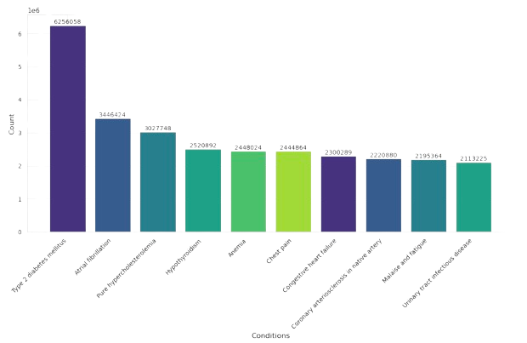
WHAT ARE THE TOP MEDICAL CONDITIONS ACROSS UNITED STATES?

Slide 8
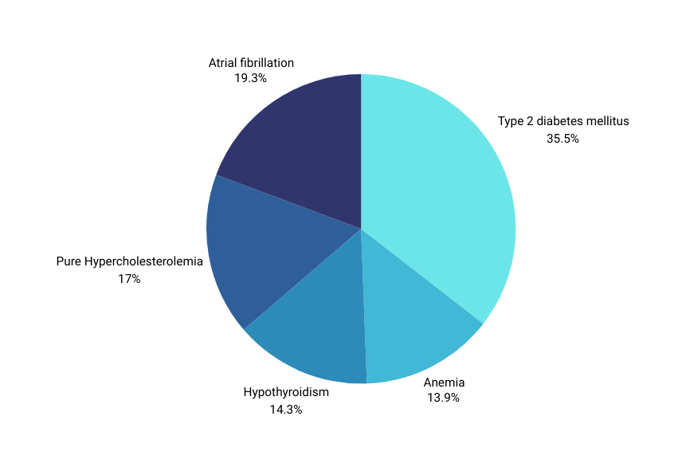


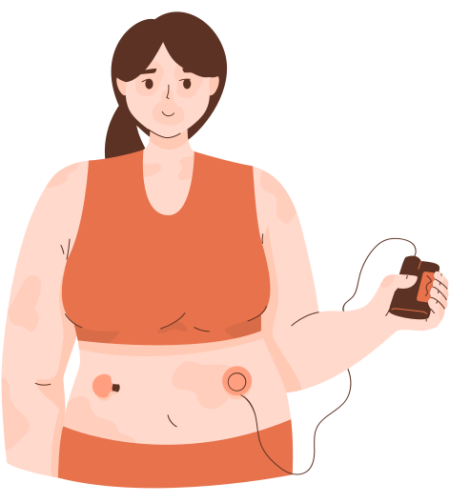
What are the variations in medical conditions observed between genders?
TOP 5 DISEASES FOR FEMALES
TOP 5 DISEASES FOR MALES

Slide 9
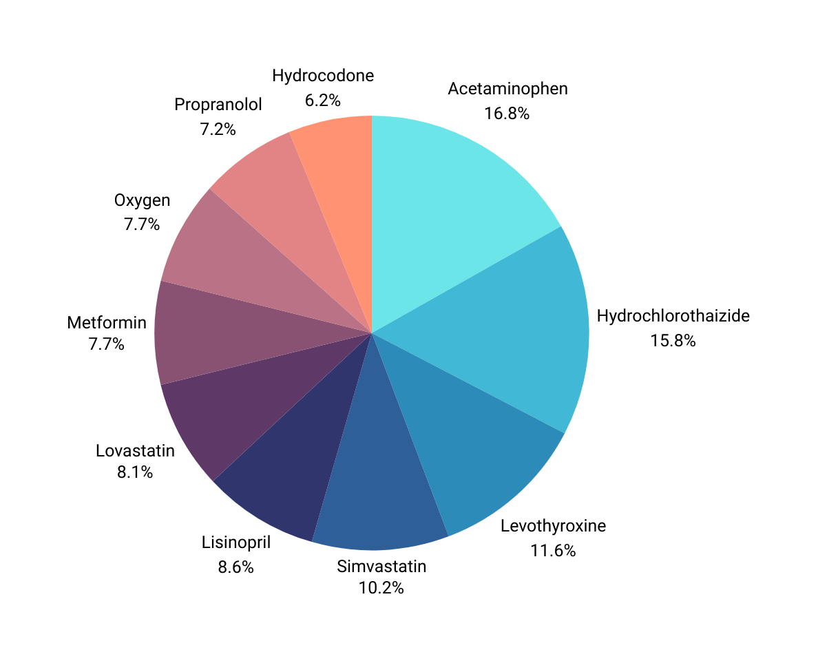
WHAT ARE THE TOP 10 MOST FREQUENTLY PRESCRIBED MEDICATIONS IN THE UNITED STATES, AND WHAT INSIGHTS DO THEY OFFER INTO MEDICATION USAGE PATTERNS AND HEALTHCARE TRENDS?

Slide 10
REGIONAL DISPARITIES IN HEALTHCARE SERVICE UTILIZATION.

Slide 11
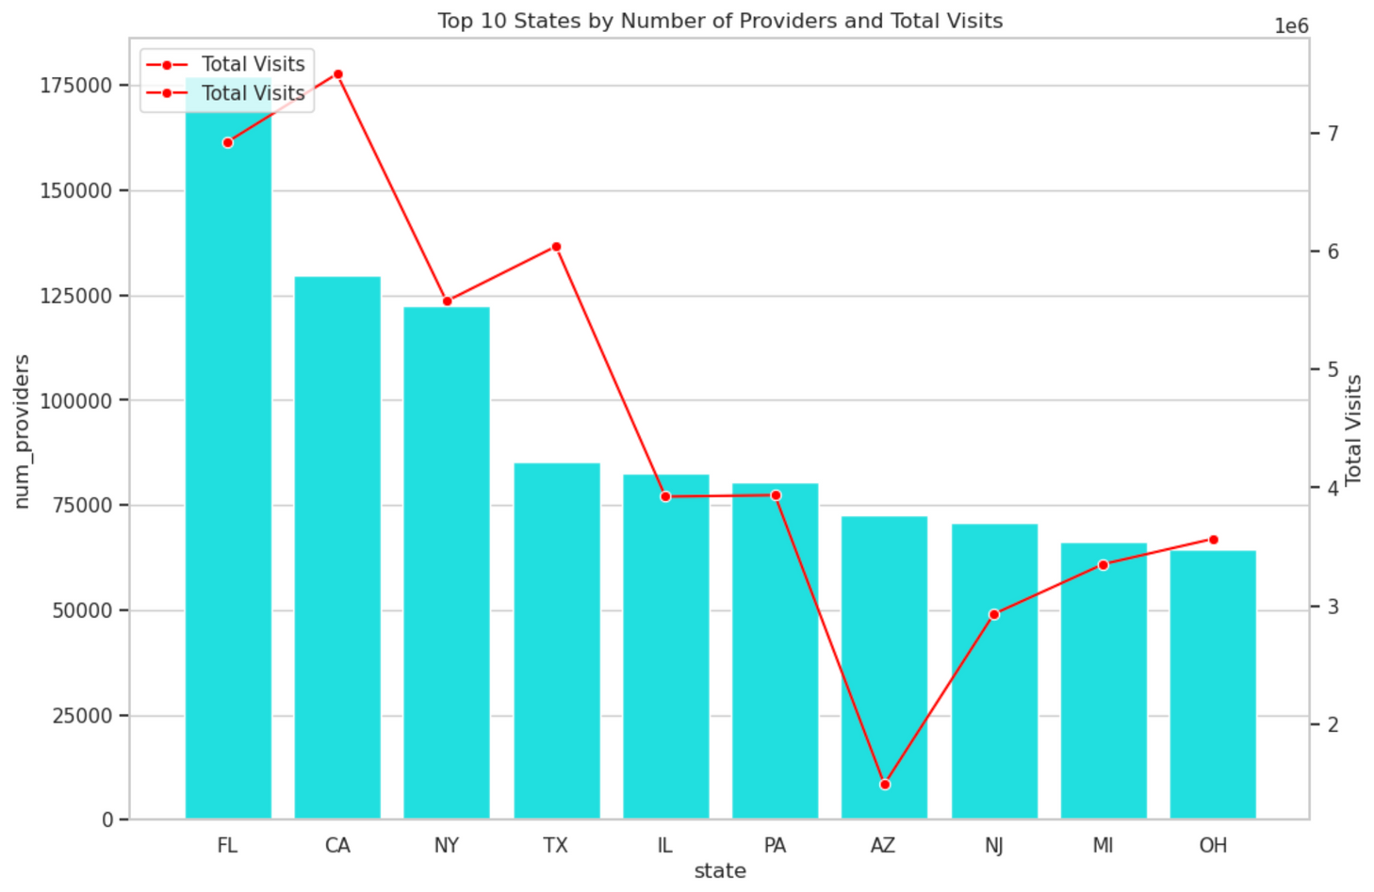
AVAILABILITY OF HEALTHCARE PROVIDERS AND PATIENT VISITS?

Slide 12
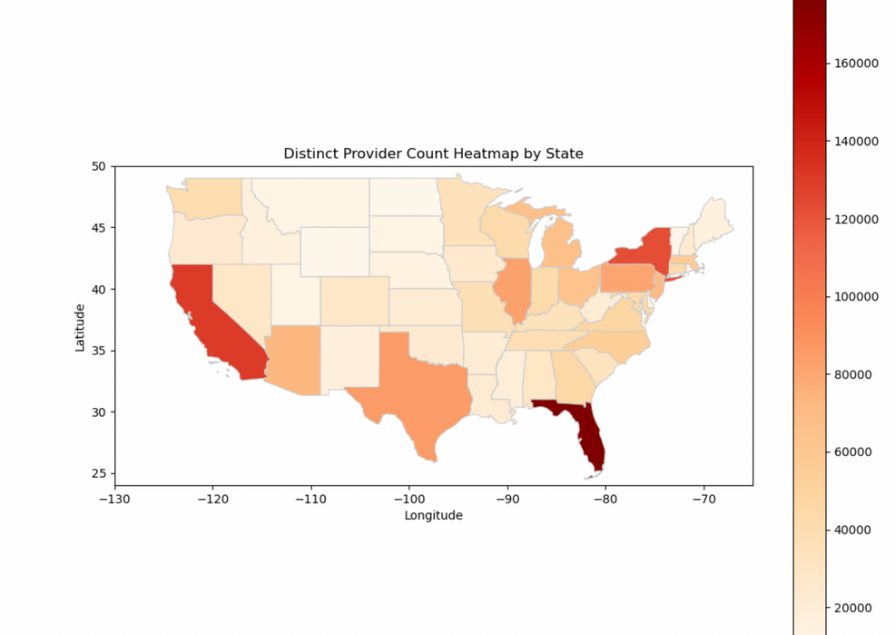
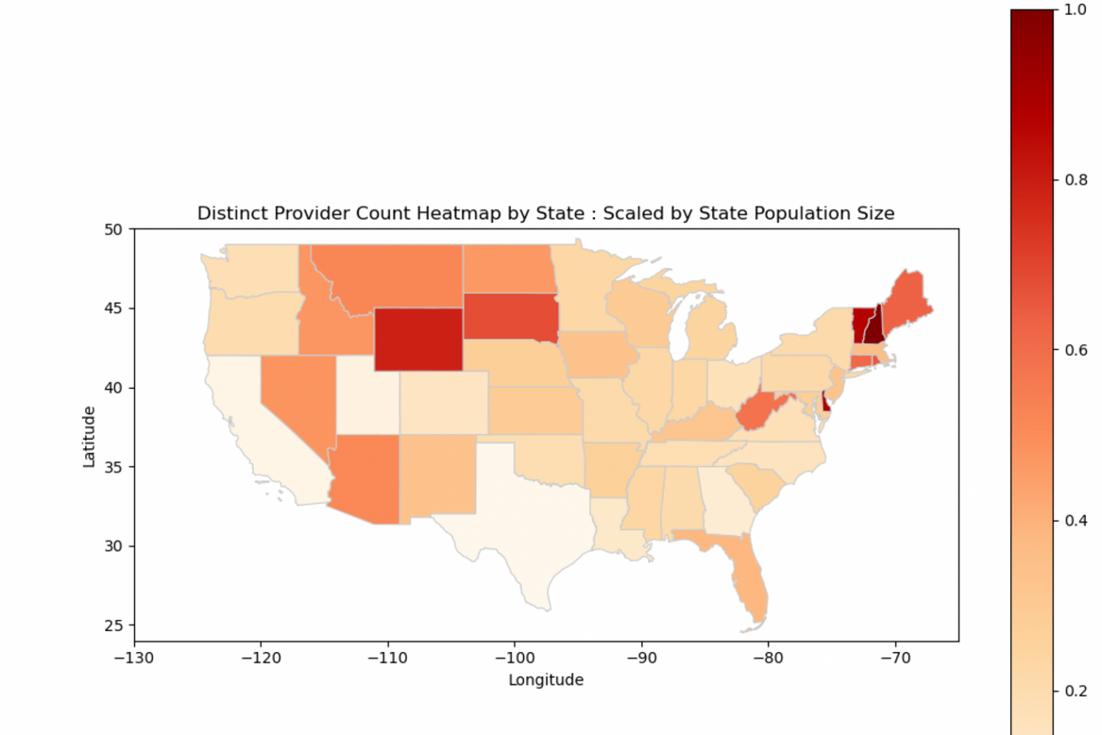
Distribution of medical providers among the different states and comparing it with US census

Slide 13
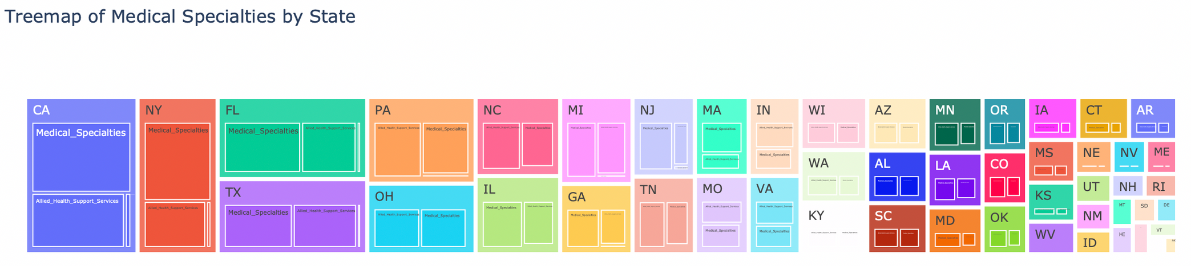
Number of medical specialties available in each state
Allied health support services
Surgical specialities
Medical Specialities

Slide 14
FINANCIAL ASPECTS OF HEALTHCARE

Slide 15

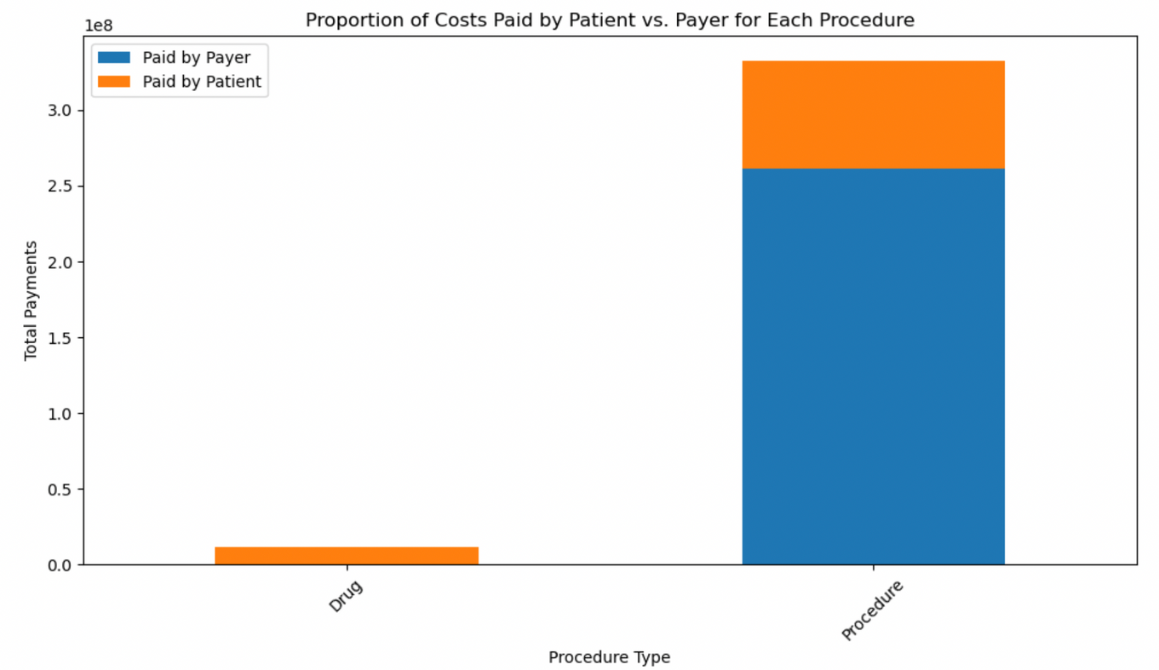
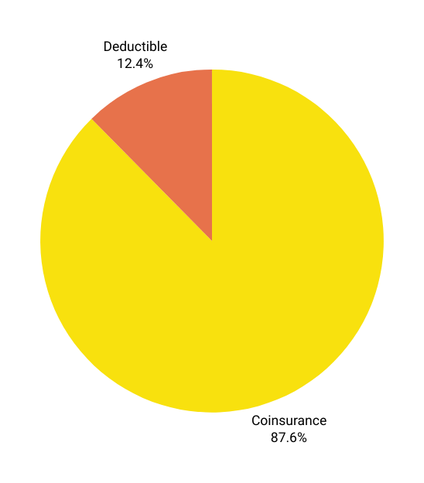
Understanding financial costs paid by the patient and insurance
Patient Share Breakdown
Total Medical Bill: $1000
Deductible: $1000*12.4% = $124
After the deductible, the remaining amount is $876
Patient Payment Using Industry Standard Coinsurance Rate(20%):
$876*20% = $175.2
Total Paid By Patient:
$124 + $175.20 = $299.20
Insurance Pays:
$876-$175.20 = $700.80
“Out-of-pocket maximum/limit.” Healthcare.gov. Retrieved from https://www.healthcare.gov/glossary/out-of-pocket-maximum-limit/ Accessed April 12, 2022. | “2021 Employer Health Benefits Survey.” November 2021. KFF. Retrieved from https://www.kff.org/report-section/ehbs-2021-summary-of-findings/

Slide 16
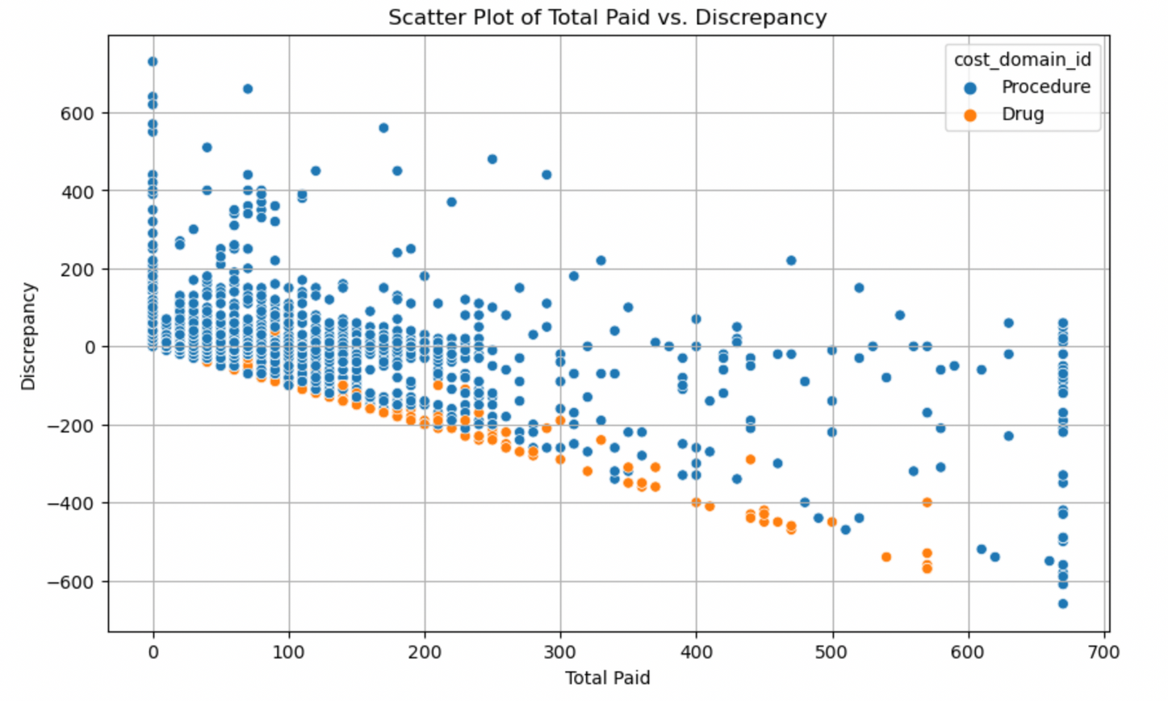
Total Cost Discrepancies Between Recorded and Calculated Values

Slide 17
UNDERSTANDING MORTALITY AND HEALTH OUTCOMES

Slide 18
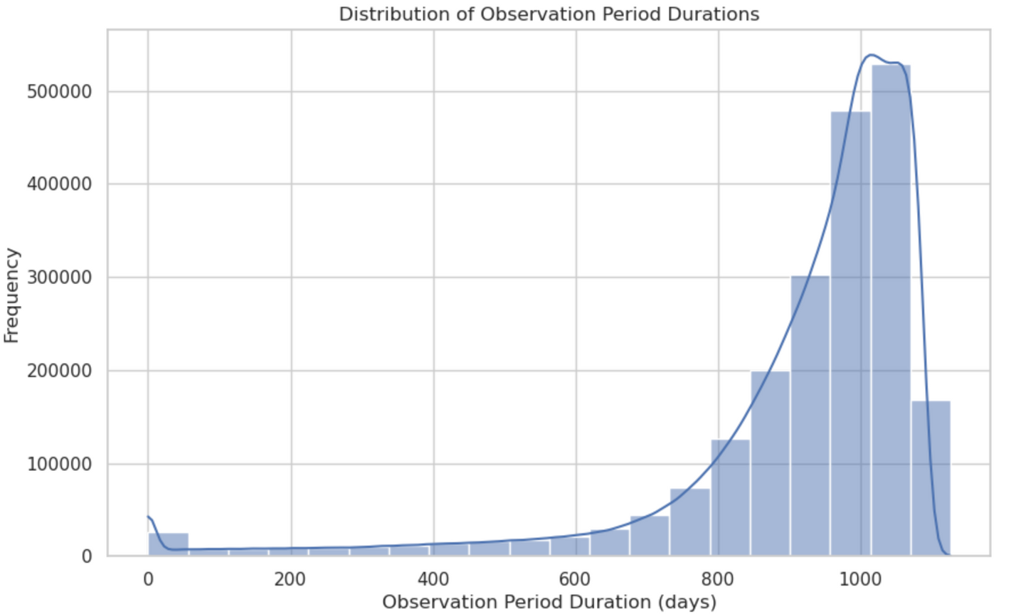

What is the recovery time and observation period for individuals who have utilized Medicare services in the United States

Slide 19
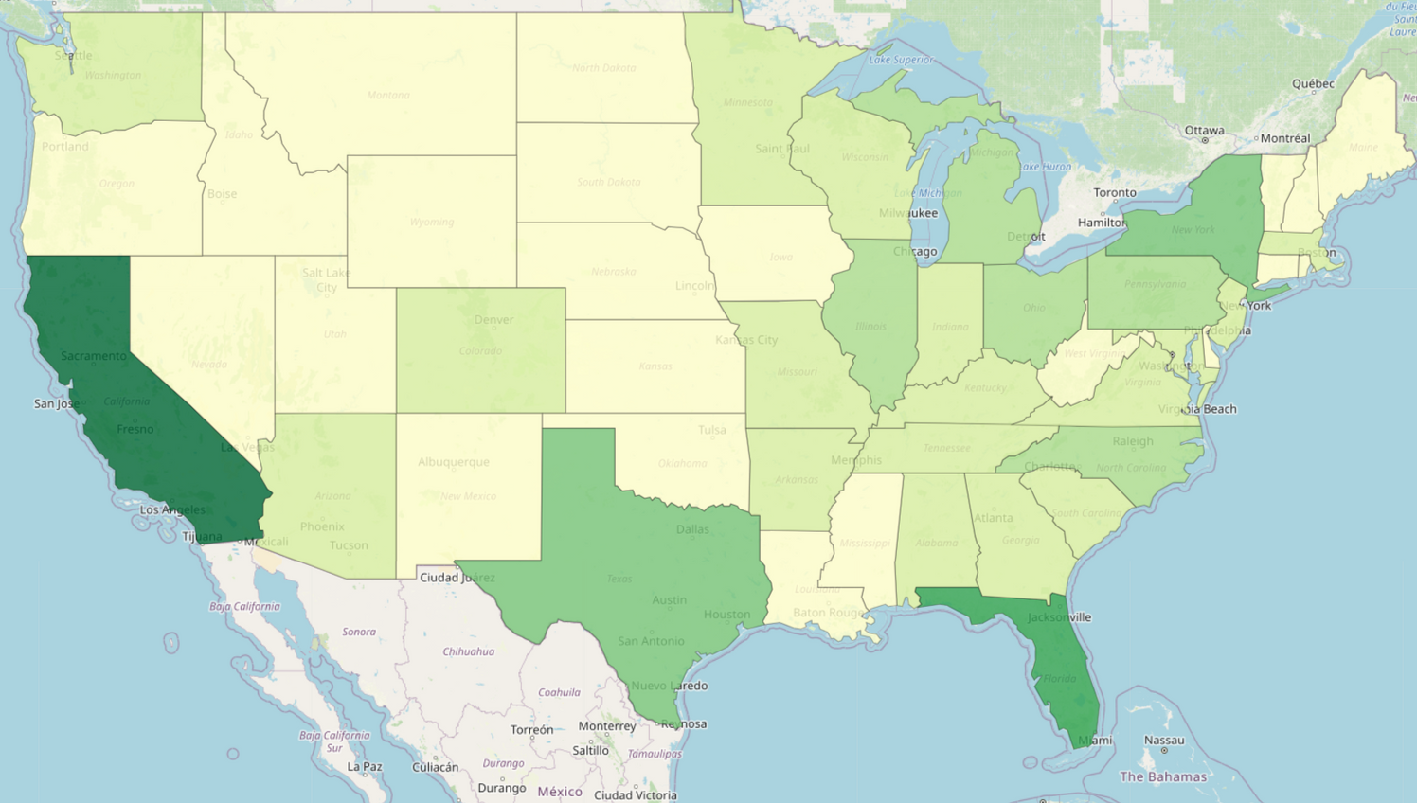
Distribution of deceased patients across different states and regions
Top States with most death count:
1. California
2. Florida
3. Texas
4. New York
Top States with least death count:
47. South Dakota
48. North Dakota
49. Vermont
50. Alaska

Slide 20
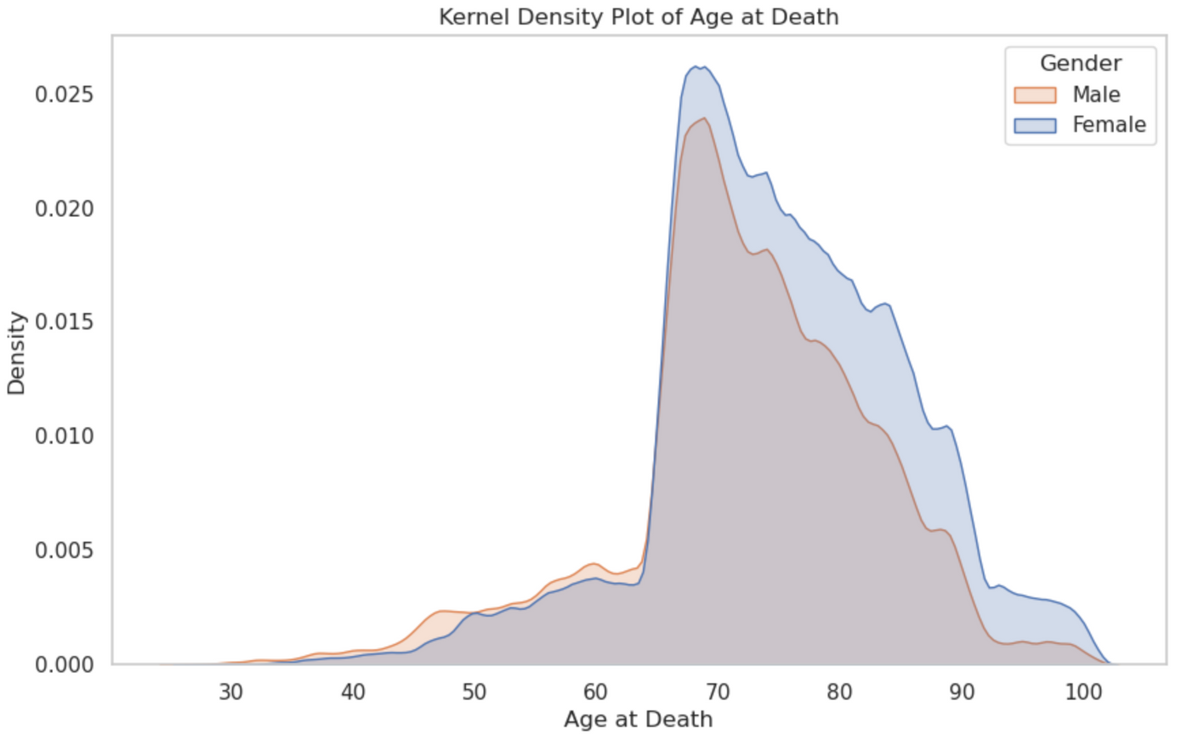
Is there a relation between the ages of patients and the patient’s sex for deceased patients?

Slide 21
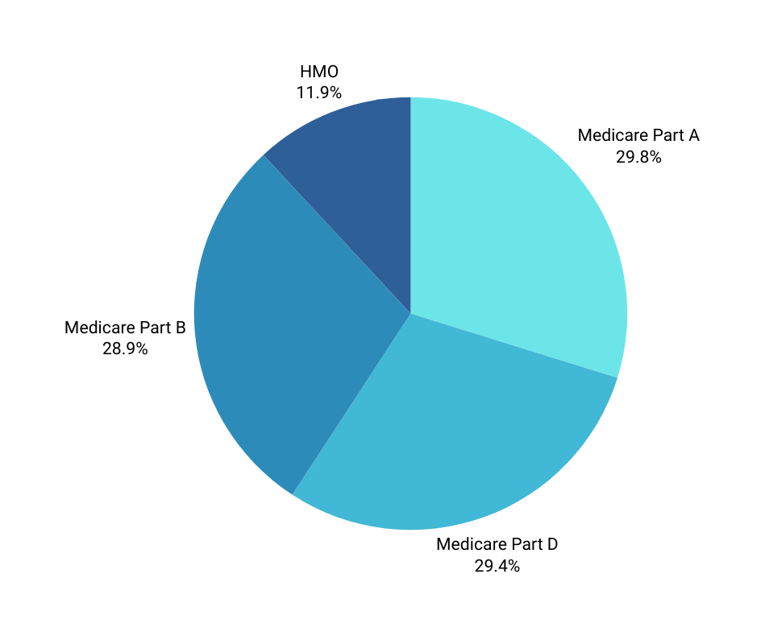
What is the distribution of medical plans across the United States?
Medicare Part A : Covers hospital care, skilled nursing, hospice, and some home health services. No premium for most who've paid Medicare taxes.
Medicare Part D : Provides prescription drug coverage through private plans. Varies in coverage, premiums, and copayments.
Medicare Part B : Covers outpatient services like doctor visits and medical equipment. Requires monthly premiums and has coinsurance/deductible costs.
HMO (Health Maintenance Organization). Managed care plan with a network of providers. Requires a primary care physician (PCP) and referrals for specialists. Focuses on preventive care and cost-effective healthcare delivery.

Slide 22
CONCLUSION & KEY FINDINGS
Type 2 diabetes mellitus & Atrial fibrillation are the most occurrent Medical Conditions across United States.
The most frequently prescribed medications in the United States are : Acetaminophen & Hydrochlorothiazide.
Florida and California had the highest patient visits across the states, and Arizona with least visists while they have relatively higher capacity
The Highest Number of medical specialties available are in Florida, California, New York & Texas.
The distribution between co-insurance and deductibles stood at 88% to 12%.
The Most observed recovery time for individuals who have utilized Medicare services was 1000 days.
Females typically have a slightly longer life expectancy compared to males.
The highest distribution of medical plans across the United States was Medicare part A.
The state with highest death count is California
The States with The lowest death count is South Dakota
Drug Costs are mostly paid by people and not insurances

Slide 23
QUESTIONS
?

